Slide 1
Investment Opportunity in Iowa
Zabumba Investments

Slide 2
Intro

Slide 3
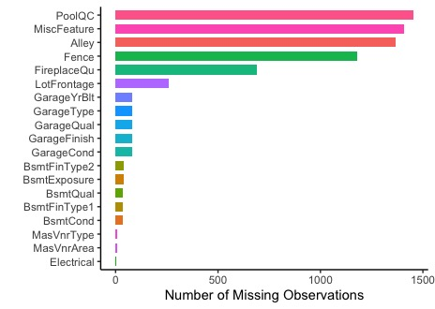
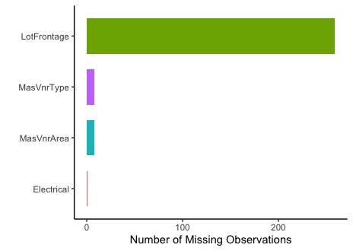
Missingness
After redefining NA values
Most NA values, are not actually missing.
For example: NA for Fence means there’s no fence
There are only 4 variables with actual missing values

Slide 4
Imputation
Lot Frontage -
Masonry Veneer Type, Masonry Veneer Area* -
Electrical System -
*Noticed inconsistency in the data, No Masonry Veneer Type with Masonry Veneer Area > 0.
Indicates data issues. Due to time constraints, I did not investigate further.

Slide 5
Feature Engineering
Total Porch Square Footage – combined existing data, and dropped
Total SF of home and Number of Floors rather than 1st and 2nd floor SF
Central Air flag changed from Y/N to binary 1/0 variable

Slide 6
Data Exploration

Slide 7
Data exploration – part 2

Slide 8

Round 1 – linear models

Slide 9
SECOND MODEL

Slide 10
Final Model

Slide 11

Questions?

